Slide 1

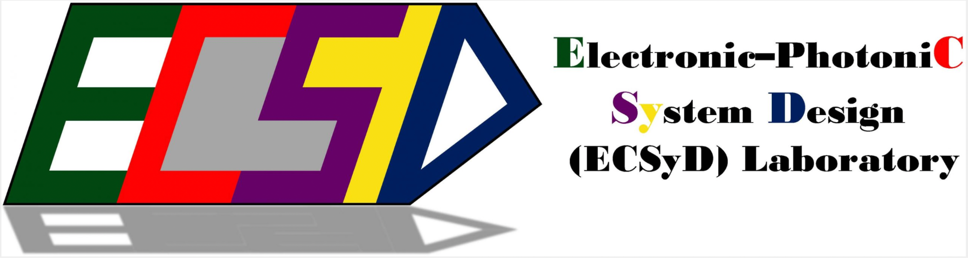
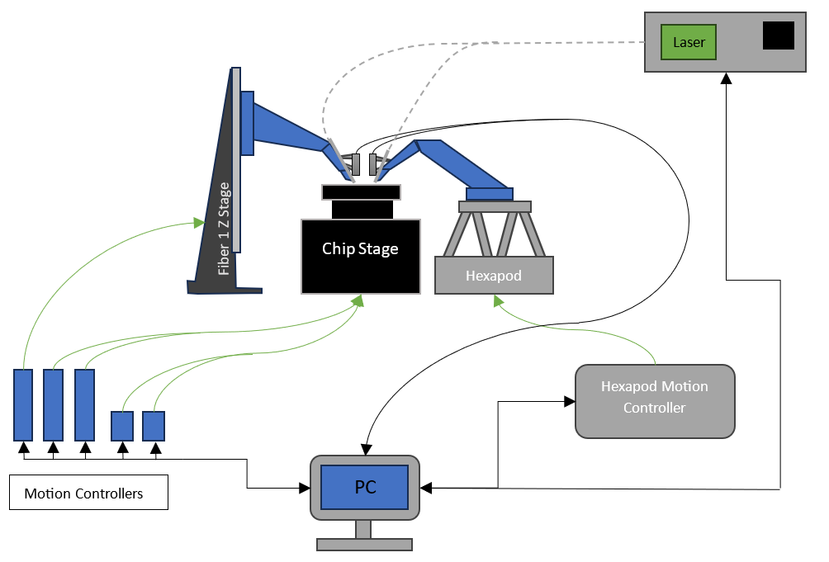
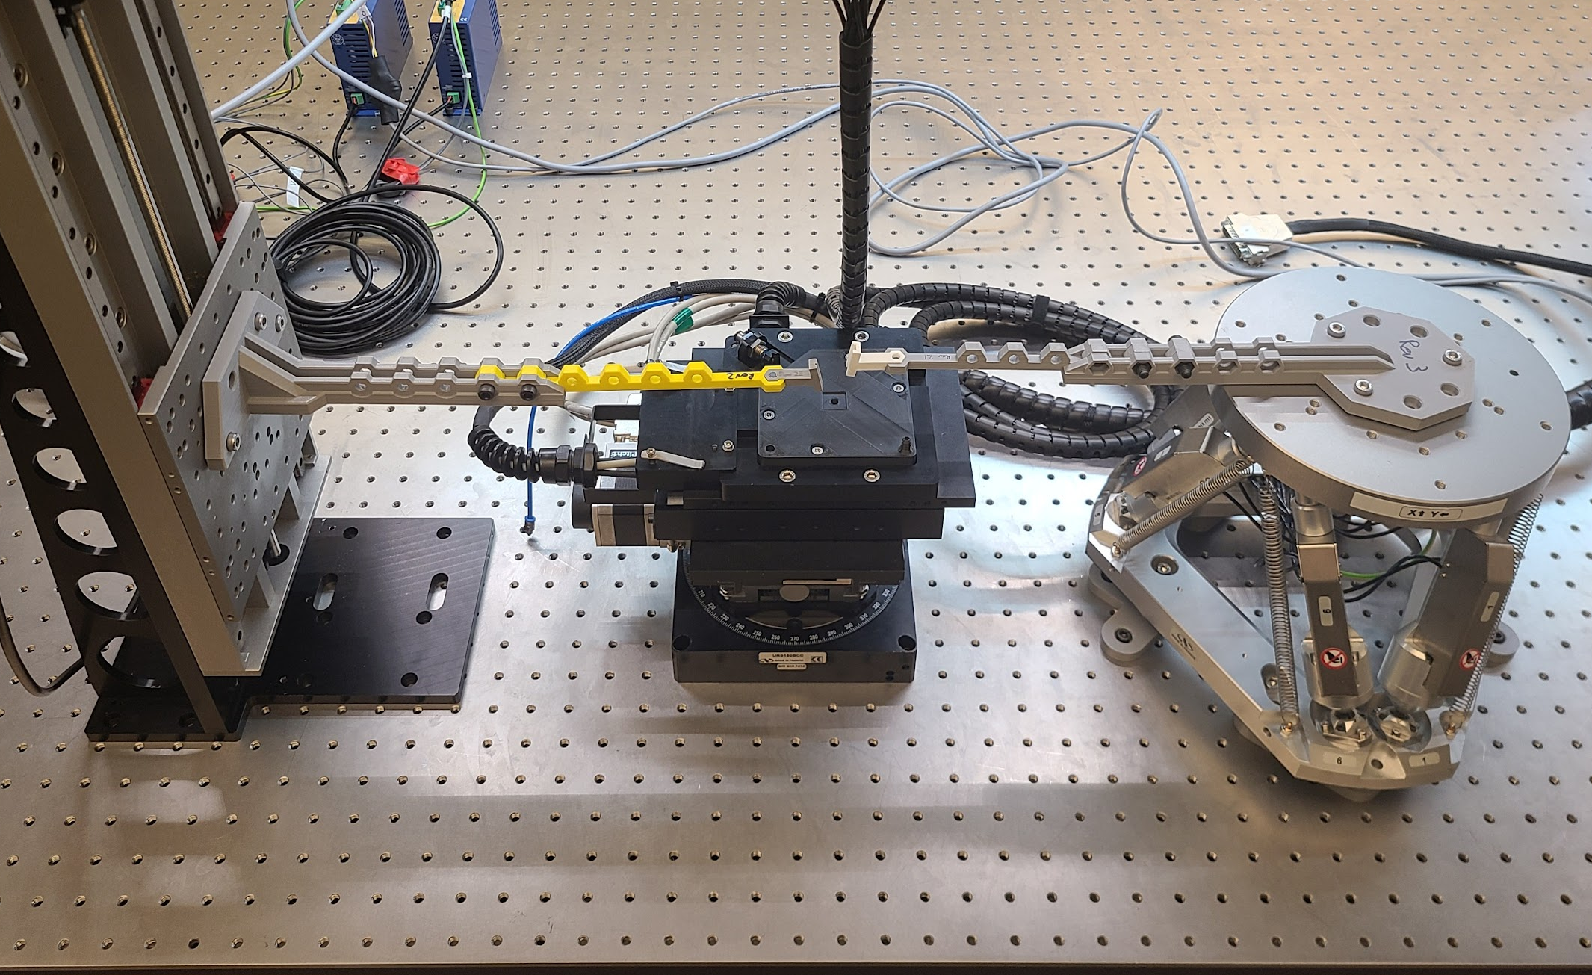
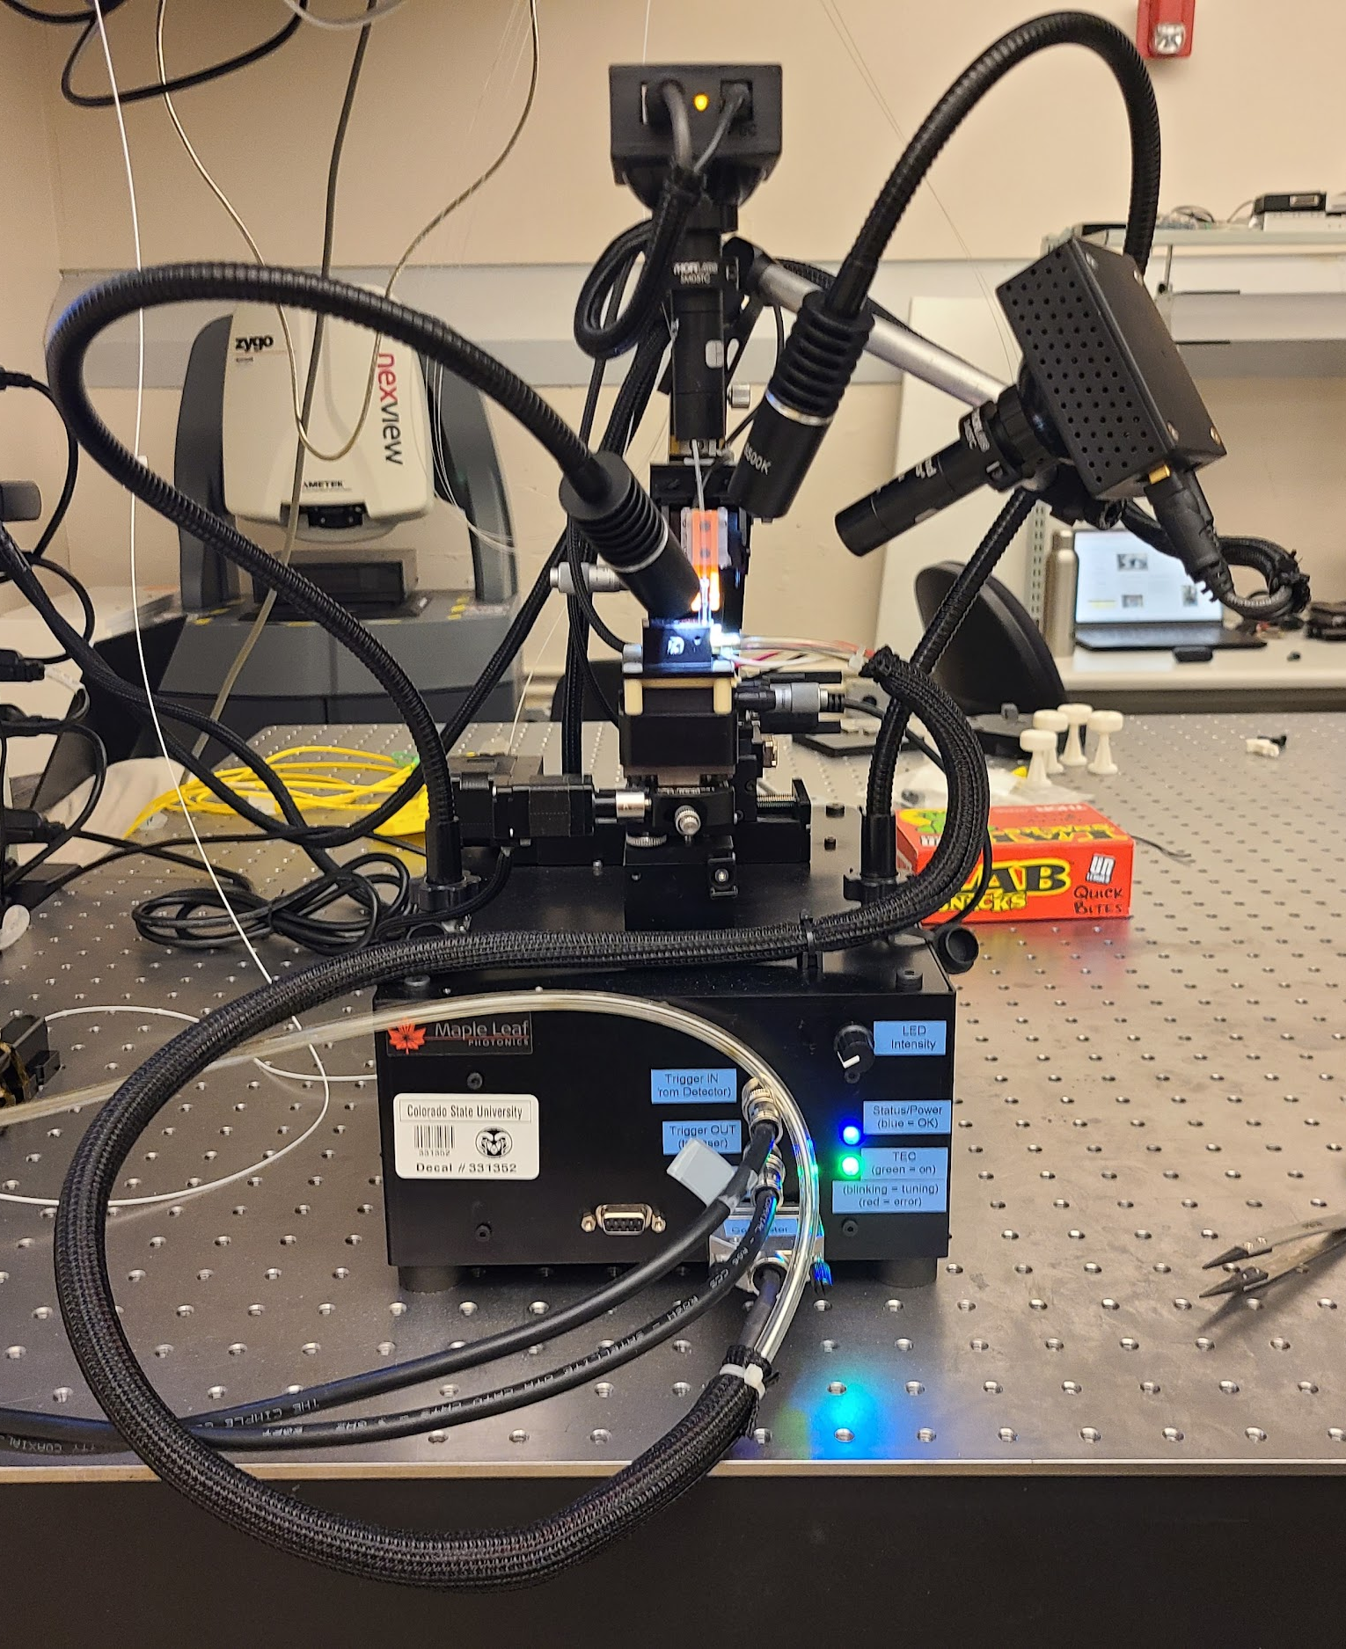
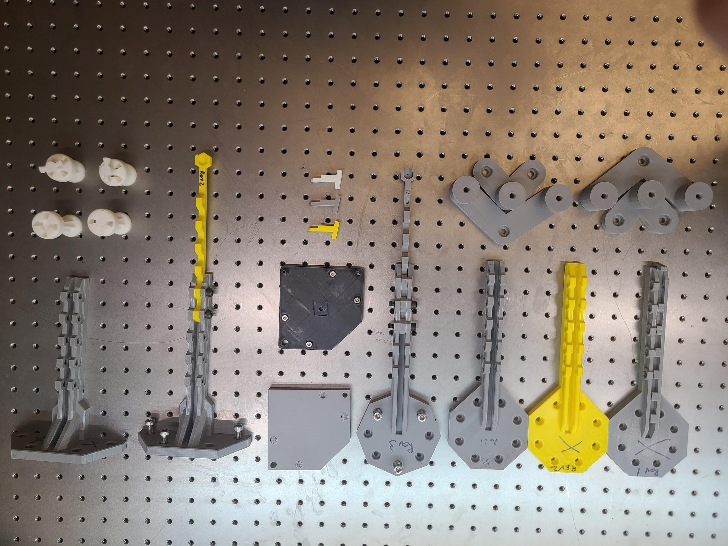
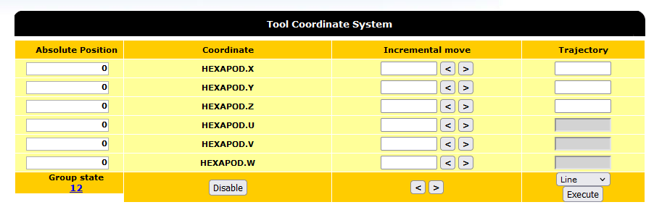
AT-PIC
Automated Testing of Photonic Integrated Chips
Automated Testing of Photonic Integrated Chips
AT - PIC
Students: Ali Algedheebi, Trent Fleming, Ben Morrison and Gavin Looney
Software Used
Testing Station Setup
Design Diagram
Testing Station Setup
36in
A3200 Motion Composer
System Setup
Goals
Purpose
Donated by HPE to control the Aerotech motors that controls the Z movement and chip stage.
Problem
Inability to utilize it due to missing configuration and setup files inadvertently deleted by HPE.
Original Goals:
Aerotech Software
Implementing Mechanical
Labview Training
Begin UI
New Goals:
Have all physical components and hardware made, mounted and wired by E-Days.
Have a useful continuation plan for future work.
Create clear documentation to aid future teams in picking up where we left off.
Labview
Current Testbench
and SiP
Purpose
Utilizing LabVIEW as the primary control platform for managing all testing station functions.
Problem
Unable to install LabVIEW on the donated computer
Z-Axis
Chipstage
Hexapod
Before designing of the new testbench began, experience in the operation of the current testbench and photonic chips was necessary. For the first semester of senior design we focused on learning to test chips using a system designed by Maple Leaf Photonics. Some of the skills learned are:
Basic Silicon Photonic (SiP) principles in ECE 544..
Device testing procedures and experience.
Fiber array alignment experience.
Custom Hardware
Donated Hardware
Hexapod Interface
In order to tailor the hardware we were give to our specific needs at ECSyD, custom hardware needed to be designed. Below is a list of some of the things created for our testbench:
Custom fiber holding arm.
Vacuum capable chip stage.
Metric to Imperial mounting blocks.
Detailed fiber array holders.
The original purpose of the project was to use donated hardware from HPE to design and implement a testing bench for photonic integrated circuits. Some of the most vital components donated to us include:
5-axis Aerotech chip stage.
6 axis newport hexapod.
Lab Computer
Various motor drivers.
High power microscopes.
In addition to this, a great deal of the hardware sent to us was not used by HP or our group. Some of the extra hardware includes:
Pneumatic actuators.
Two axis linear stage.
Single axis linear stages.
Digital oscilloscopes.
Purpose
Used to control the second fiber arm.
Abilities
Has full 6 axis of motion control of x, y, z, yaw, pitch, and roll axis.
Can move around a set pivot point.
Interface
Connects to a Newport motion controller, which provides a user-friendly web interface for the hexapod.
Drawbacks:
While a useful tool. this station has its limitations. For example, the single fiber array design imposes significant constraints on chip design in order to be compatible with this station.
Notes:
Design diagram larger
Remove Whitespace

